Slide 1

Transportation Planning Nashville, TN
Scooter Snatchers

Slide 2
Agenda
Keep Companies making Profits
Discourage Piling of Scooters
Transportation Goals

Slide 3

Keep Companies Making Profits
How does Metro Nashville keep Micromobility Profitable in 2021?

Slide 4
Keep Companies Making Profits
[Basic Stats for Scooters and Companies]
Bar chart of Count of Scooters by Company by Month
Work with companies that have lower percentages of Scooters
Rethink about what scooter companies to contract with
Ads for scooters or “Grand Opening”
Initiative for more sidewalks around Nashville include rebranding of “Scooter Etiqutte”
Incentives for lesser known companies to be last mile solutions
Standardize reporting data for scalability
Bus pass gives discounts for scooter riders
Have Scooter Juicers redistribute scooters in Promise Zone

Slide 5
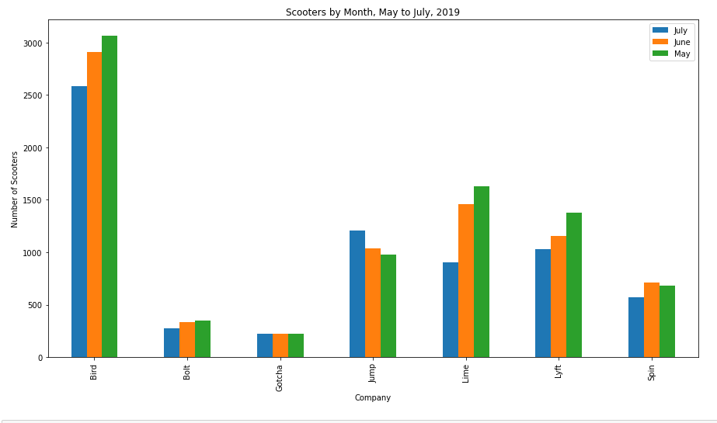

Slide 6
Discourage Piling of Scooters

Slide 7
Discourage Piling of Scooters
Incentive for parking scooter in a certain area
Discount on next ride
Discount on existing ride
Work with Scooter Parking Companies to assist with charging and parking of scooters
Swiftmile
Deadzone
Signage to direct scooter riders to of approaching deadzones
Where to place scooters inside the deadzone
Vocalize countdown warning of deadzone
[Heat Map of Stationary Data]
Rush Hour Data

Slide 8
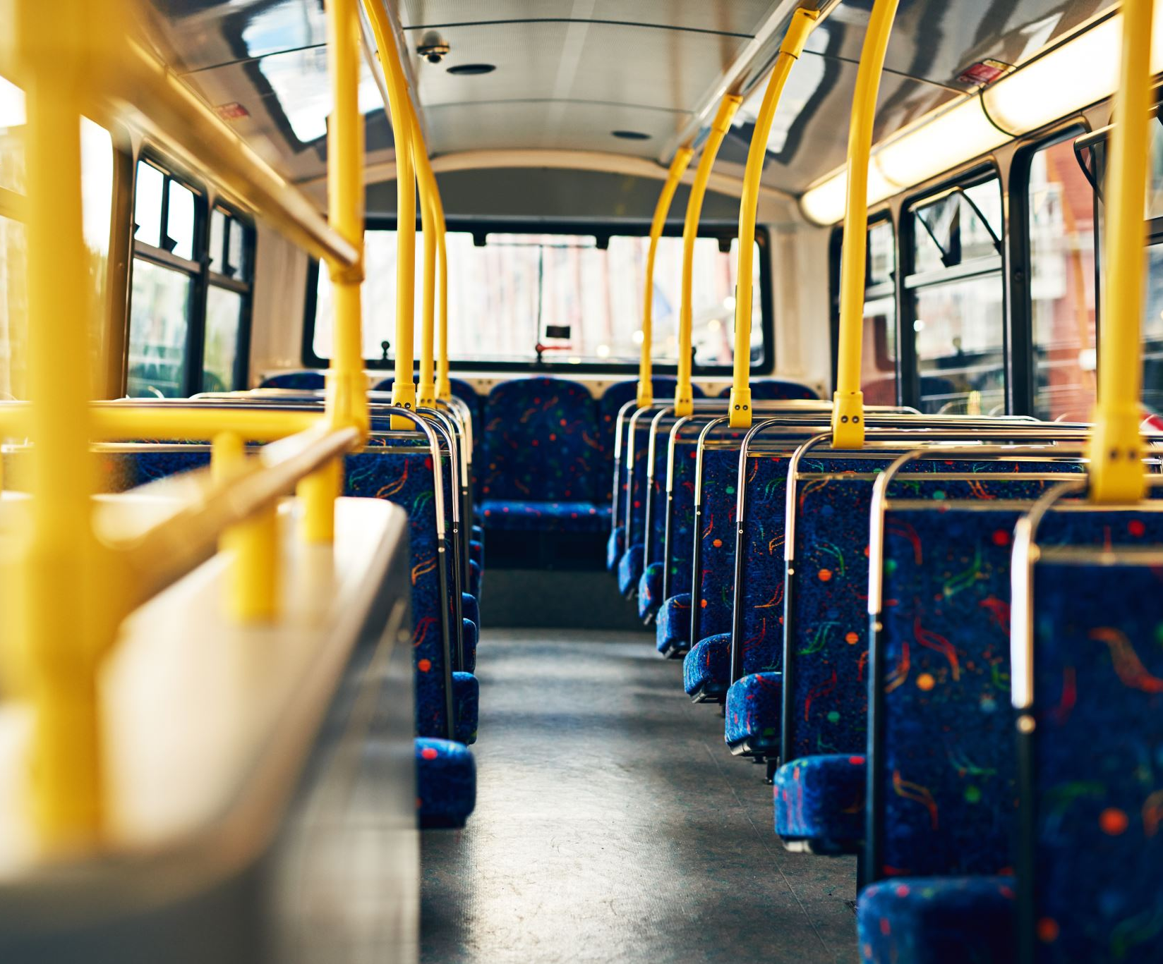
Transportation Goals
Reduce Single Drivers
Mitigate Last Mile
Three by Three

Slide 9
Reduce Single Drivers by SUMD
Making sure the scooters are in the promise zones
Match scooters with bus stops [Stationary & Trip Data Folium Map]
Scooter Riding times

Slide 10
Mitigate Last Mile Challenges
SUMD devices may be an important means of transportation in the Promise Zone to help mitigate the “last mile” problem that exists in connecting people where they live to public transportation.

Slide 11
Three by Three
Three rides (of 3 meters or more) per day per scooter is the baseline for ridership goals.
- Trip Data will answer this

